Slide 1
Line Drawing Algorithms
A line in Computer graphics is a portion of straight line that extends indefinitely in opposite direction.
It is defined by its two end points.
Its density should be independent of line length.
the slope intercept equation for a line:
y = mx + b (1)
where, m = Slope of the line
b = the y intercept of a line

Slide 2
The two endpoints of a line segment are specified at positions (x1,y1) and (x2,y2).
y
P2(x2,y2)
P1(x1,y1)
b
0
x

Slide 3
We can determine the value for slope m & b intercept as
m = y2-y1/x2-x1
i.e. m= Δy/ Δx (2)

Slide 4
Example 1 The endpoints of line are(0,0) & (6,18). Compute each value of y as x steps from 0 to 6 and plot the result.
Solution : Equation of line is y= mx +b
m = y2-y1/x2-x1= 18-0/6-0 = 3
Next the y intercept b is found by plugging y1& x1 into the equation y = 3x + b,
0 = 3(0) + b. Therefore, b=0, so the equation for the line is y= 3x.

Slide 5
The challenge is to find a way to calculate the next x,y position by previous one as quickly as possible.

Slide 6
DDA Algorithm
The Digital differential analyzer (DDA) algorithm is an incremental scan-conversion method.
Such an approach is characterized by performing calculations at each step using results from the preceding step.

Slide 7
Algorithm:
(x1,y1) (x2,y2) are the end points and dx, dy are the float variables.
Where dx= abs(x2-x1) and dy= abs(y2-y1)
(i) If dx >=dy then
length = dx
else
length = dy
endif

Slide 8
(ii) dx = (x2-x1)/length
dy = (y2-y1)/length
(iii) x = x1 + 0.5
y = y1 + 0.5
(iv) i = 0
(v) Plot ((x), (y))
(vi) x = x + dx
y = y + dy
(vii) i = i + 1

Slide 9
(viii) If i < length then go to step (v)
(ix) Stop
Example 2 Scan convert a line having end points (3,2) & (4,7) using DDA.
Solution: dx= x2 - x1 = 4-3 = 1
dy= y2 - y1 = 7-2 = 5
As, dx < dy then
length = y2-y1 = 5
dx = (x2-x1)/ length = 1/5 =0.2
dy = (y2-y1)/ length = 5/5 = 1

Slide 10
x1 | y1 | x2 | y2 | L | dx | dy | i | x | y | Result | Plot
3 | 2 | 4 | 7 | 5 | .2 | 1 | 0 | 3.5 | 2.5 | 3.5, 2.5 | 3,2
 |  |  |  |  |  |  | 1 | 3.7 | 3.5 | 3.7,3.5 | 3,3
 |  |  |  |  |  |  | 2 | 3.9 | 4.5 | 3.9,4.5 | 3,4
 |  |  |  |  |  |  | 3 | 4.1 | 5.5 | 4.1,5.5 | 4,5
 |  |  |  |  |  |  | 4 | 4.3 | 6.5 | 4.3,6.5 | 4,6
 |  |  |  |  |  |  | 5 | 4.5 | 7.5 | 4.5,7.5 | 4,7

Slide 11
Limitations of DDA:
The rounding operation & floating point arithmetic are time consuming procedures.
Round-off error can cause the calculated pixel position to drift away from the true line path for long line segment.

Slide 12


Slide 13
The Bresenham Line Algorithm
The Bresenham algorithm is another incremental scan conversion algorithm
The big advantage of this algorithm is that it uses only integer calculations

Slide 14
The Big Idea
Move across the x axis in unit intervals and at each step choose between two different y coordinates
For example, from position (2, 3) we have to choose between (3, 3) and (3, 4)
We would like the point that is closer to the original line
5
(x_{k}+1, y_{k}+1)
4
(x_{k}, y_{k})
3
(x_{k}+1, y_{k})
2
2
3
4
5

Slide 15
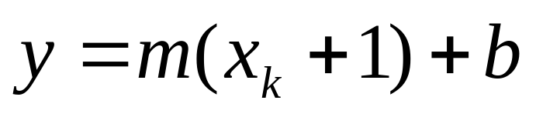
Deriving The Bresenham Line Algorithm
At sample position x_{k}+1 the vertical separations from the mathematical line are labelled d_{upper} and d_{lower}
y_{k+1}
d_{upper}
y
d_{lower}
y_{k}
x_{k}+1
The y coordinate on the mathematical line at x_{k}+1 is:

Slide 16
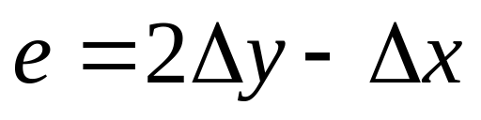
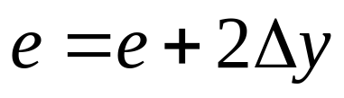
The Bresenham Line Algorithm
BRESENHAM’S LINE DRAWING ALGORITHM
Input the two line end-points, storing the left end-point in (x₁, y₁)
Calculate the constants Δx i.e. dx, Δy i.e. dy, 2Δy and 2 Δx, get the first value for the decision parameter as:
Initialise starting
Initialise i=1 as a counter,

Slide 17
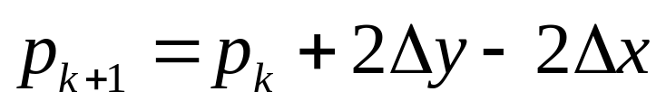
The Bresenham Line Algorithm (cont…)
Otherwise, the next point to plot is (x_{k}+1, y_{k}+1) and:
Repeat step 4 (Δx – 1) times
ACHTUNG! The algorithm and derivation above assumes slopes are less than 1. for other slopes we need to adjust the algorithm slightly.

Slide 18
Adjustment
For m>1, we will find whether we will increment x while incrementing y each time.
After solving, the equation for decision parameter p_{k} will be very similar, just the x and y in the equation will get interchanged.

Slide 19
Bresenham Example
Let’s have a go at this
Let’s plot the line from (20, 10) to (30, 18)
First off calculate all of the constants:
  Δx: 10
  Δy: 8
  2Δy: 16
  2Δy - 2Δx: -4
Calculate the initial decision parameter p₀:
  p0 = 2Δy – Δx = 6

Slide 20
Bresenham Example (cont…)
k | p_{k} | (x_{k+1},y_{k+1})
0 1 2 3 4 5 6 7 8 9
18
17
16
15
14
13
12
11
10
20
21
22
23
24
25
26
27
28
29
30

Slide 21
Bresenham Exercise
Go through the steps of the Bresenham line drawing algorithm for a line going from (21,12) to (29,16)

Slide 22
Bresenham Exercise (cont…)
k | p_{k} | (x_{k+1},y_{k+1})
0 1 2 3 4 5 6 7 8
18
17
16
15
14
13
12
11
10
20
21
22
23
24
25
26
27
28
29
30

Slide 23
Bresenham Line Algorithm Summary
The Bresenham line algorithm has the following advantages:
  An fast incremental algorithm
  Uses only integer calculations
Comparing this to the DDA algorithm, DDA has the following problems:
  Accumulation of round-off errors can make the pixelated line drift away from what was intended
  The rounding operations and floating point arithmetic involved are time consuming

